Slide 1

A06
Forecasting with Nixtla
Nicolas Giot
ITAI IIOT & AI at the Edge

Slide 2
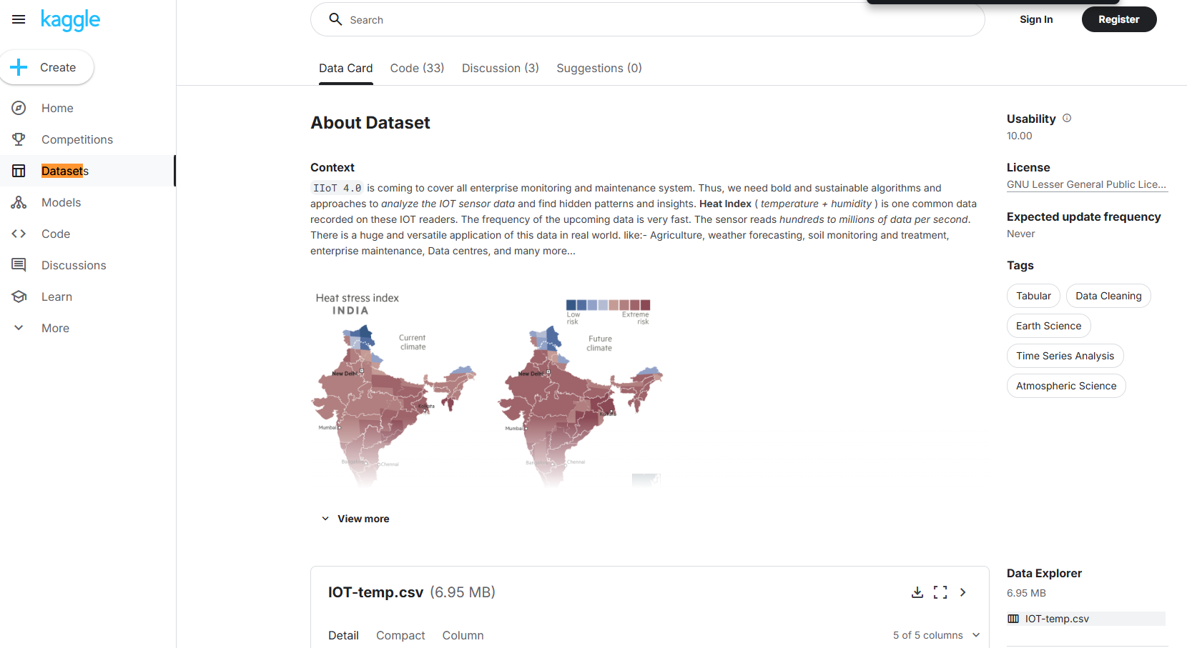
Introduction
Meaning of project
Kaggle dataset: IoT temperature readings from indoor & outdoor sensors
Focused on indoor data to model controlled environments (e.g., HVAC systems)
Objective: Forecast future indoor temperatures using AutoML and test generative augmentation
Real-world application: Smart buildings, energy optimization, IIoT systems

Slide 3
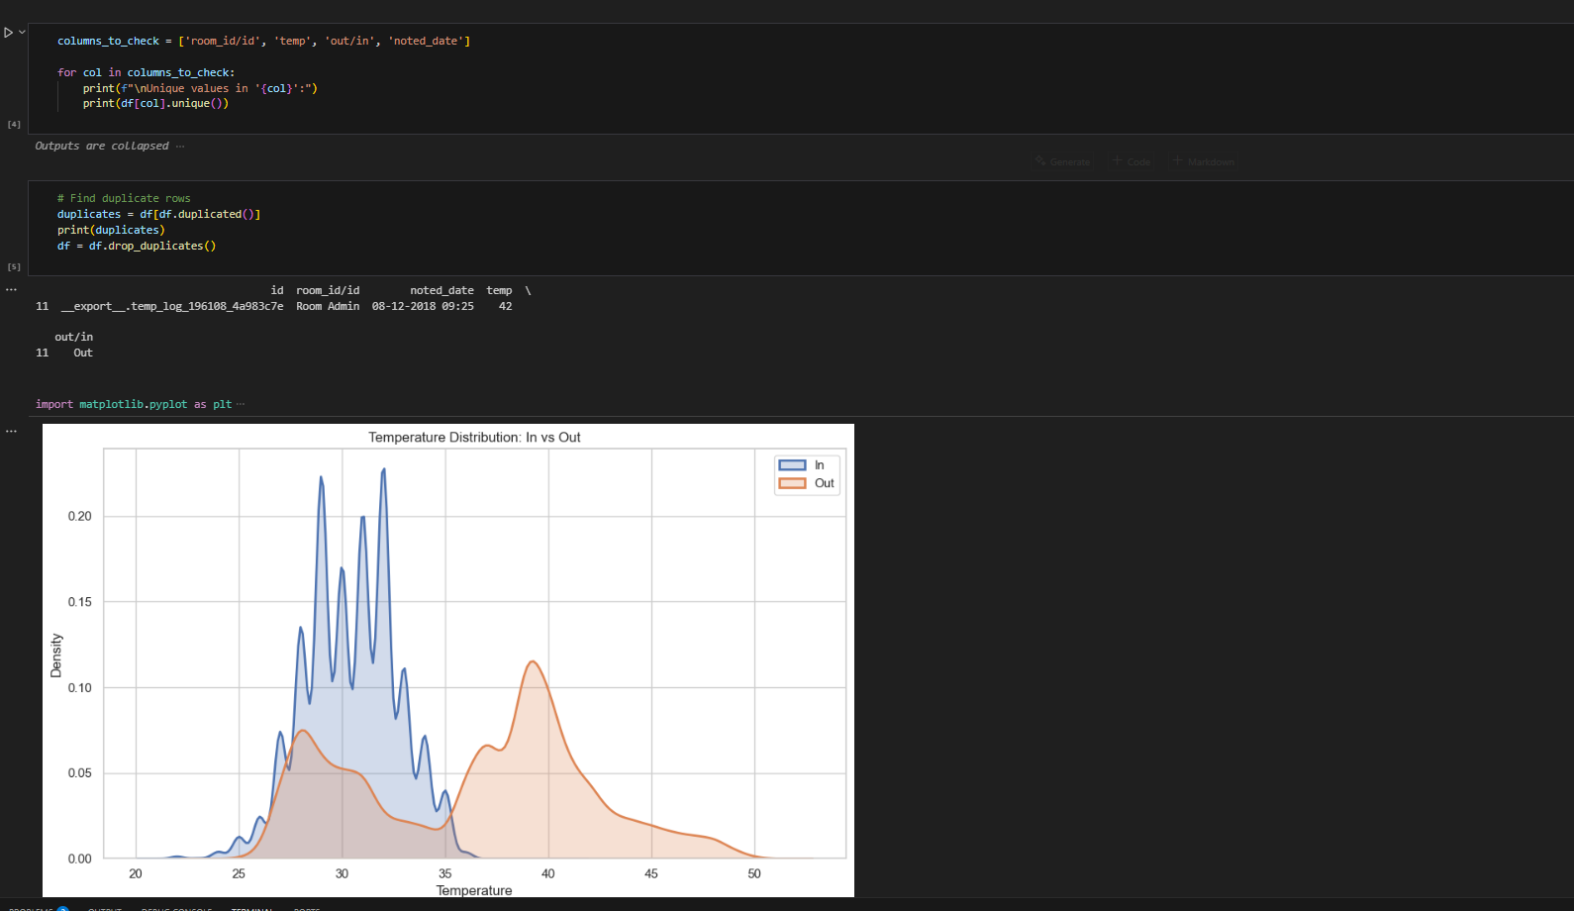
Dataset
Preprocessing
Converted noted_date using format='mixed' due to inconsistent timestamp formats
Discovered and removed a duplicate row by checking full-row duplication
Lowercased and stripped the out/in column for consistency ('in', 'out')
Removed indoor outliers where temp > 36°C (based on IQR logic)
Learned the data had:
~20k indoor rows, mostly centered around 29–31°C
A few suspicious outliers (like 41°C indoors)

Slide 4
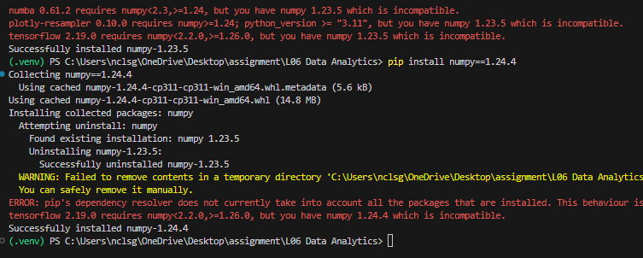
Virtual venv
Environment Setup
Encountered TensorFlow vs NumPy version mismatch (np.bool deprecation)
Downgrading NumPy broke Numba, a StatsForecast dependency
Solved by restructuring the code to work symbolically in Keras without downgrading
Insight: Real ML work often starts with fixing your environment

Slide 5
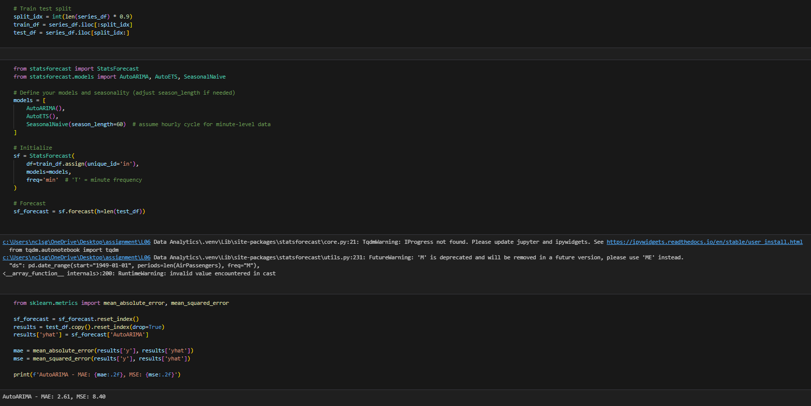
Nixtla Model
Training and Prep
Used Nixtla’s StatsForecast AutoML suite:
AutoARIMA: Best-performing
AutoETS: Trend-seasonality model
SeasonalNaive: Simple baseline
Split: 90% training, 10% testing on minute-level indoor data
Forecast horizon: same length as test set

Slide 6
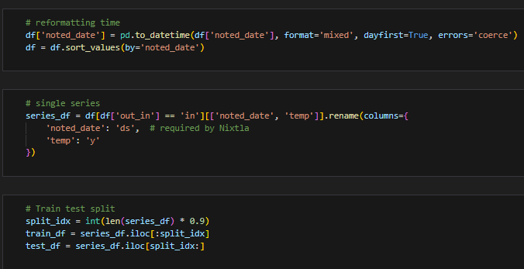
Engineering
Features
Added two time-based features:
hour: Captures natural temperature cycles (day/night)
dayofweek: Captures weekday vs. weekend HVAC behavior
These features are relevant in IIoT building management contexts
Helped understand human patterns in the data (e.g., stable night temps, weekday spikes)

Slide 7
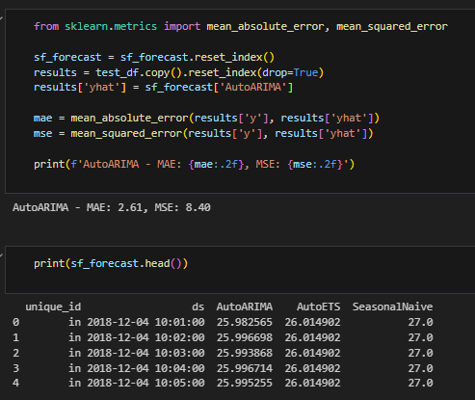
Evaluation
And augmentation
Visualized forecast vs. actual with AutoARIMA
Initial performance:
MAE: 2.61
MSE: 8.40
SeasonalNaive underperformed → validated Nixtla’s model choice
Discovered some over-smoothing, prompting exploration of data augmentation

Slide 8
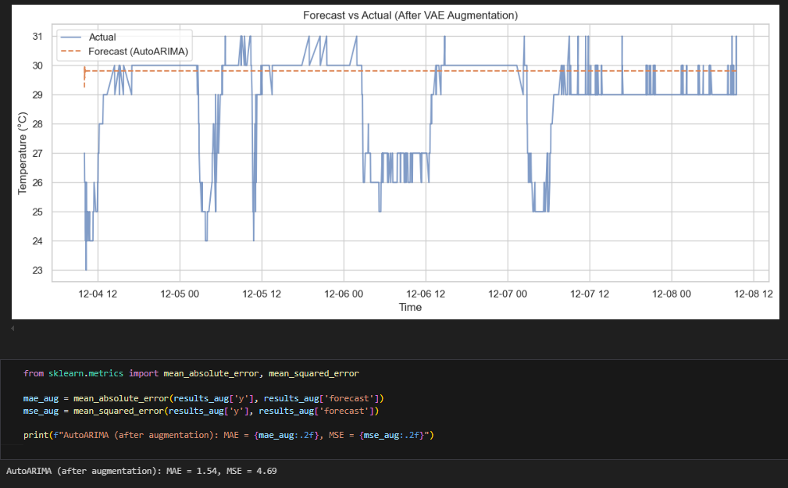
VAE
Generative Model
Built a Variational Autoencoder (VAE) to learn temperature patterns
Used custom Sampling layer to add KL divergence loss cleanly
Generated 100 synthetic temperature values from latent space
Appended synthetic data with new timestamps to training set
Retrained StatsForecast model on augmented dataset

Slide 9
Results
My Takeaways
After VAE augmentation:
Improved forecast alignment with test data
MAE/MSE decreased slightly (more robust short-term trends)
Takeaways:
Clean, labeled data matters more than size
Nixtla’s AutoML is powerful but depends on good preprocessing
VAE augmentation can be practical even in low-noise IIoT settings
Recommendation: Pair traditional forecasting models with light generative tools in edge/IoT workflows

